Slide 1
Progress Report: Nakuja N3
AIRFRAME TEAM • 02.22.2023

Slide 2
Overview
Recent progress
Fabrication of the airframe(Fiberglass)#20
Revision of the parameters#6
Design of the fin alignment jig#23
Yet to be finalised
Procurement of fibreglass material and Aluminum
Redesign of the launch rod

Slide 3
Progress - Fabrication of the fibreglass airframe#20
Accomplishment 1
We begun training on how to fabricate the fibreglass airframe
The first attempt was somewhat a success
To do
Improve on the fabrication techniques
Adapt a paint brush instead of a roller during fabrication

Slide 4
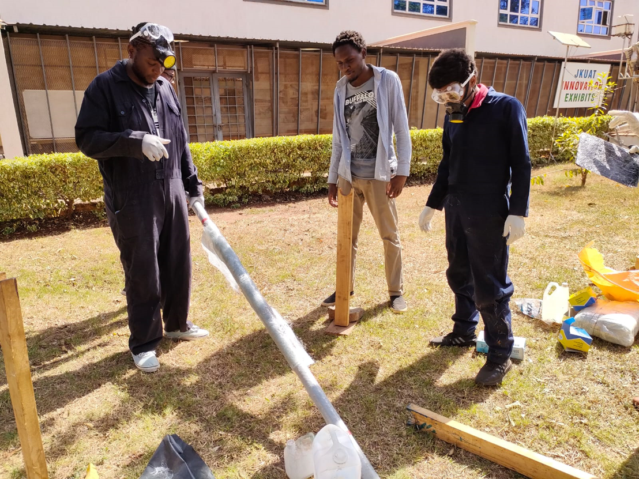
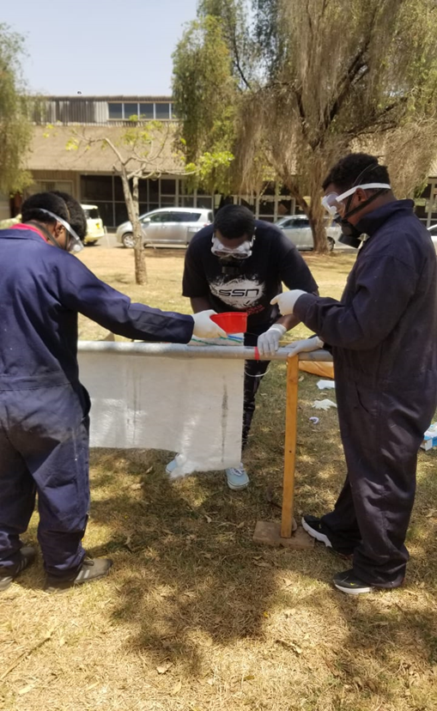
Fibreglass fabrication take one:)

Slide 5
Progress - Revision of parameters
On-going
The revision of parameters is still ongoing.
We optimized the rocket parameters from the open rocket software generated excel sheets.

Slide 6
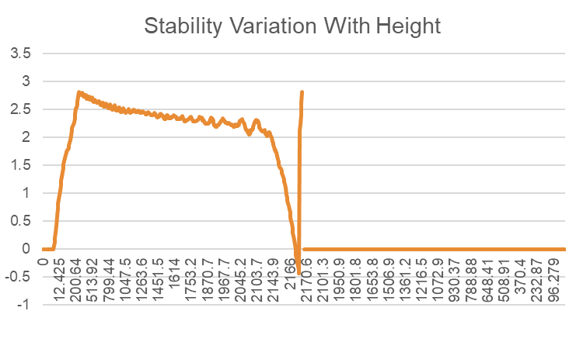
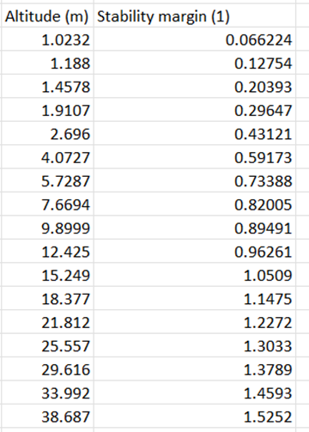
Stability variation vs the altitude.

Slide 7
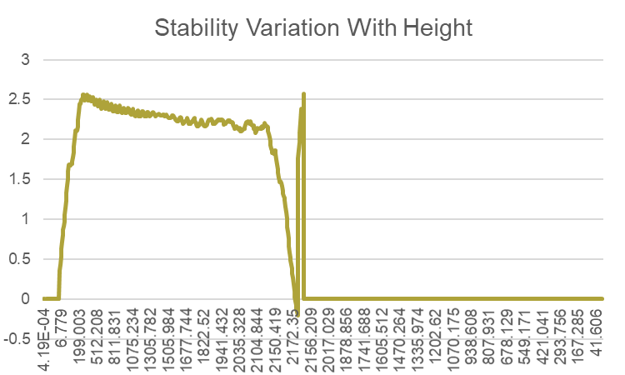
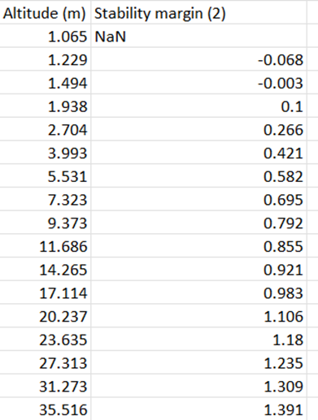
Stability variation vs the altitude..

Slide 8
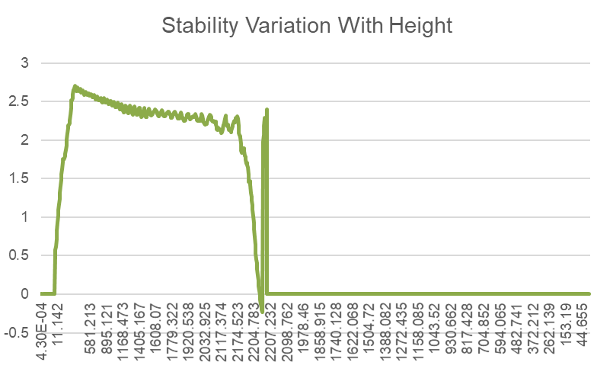
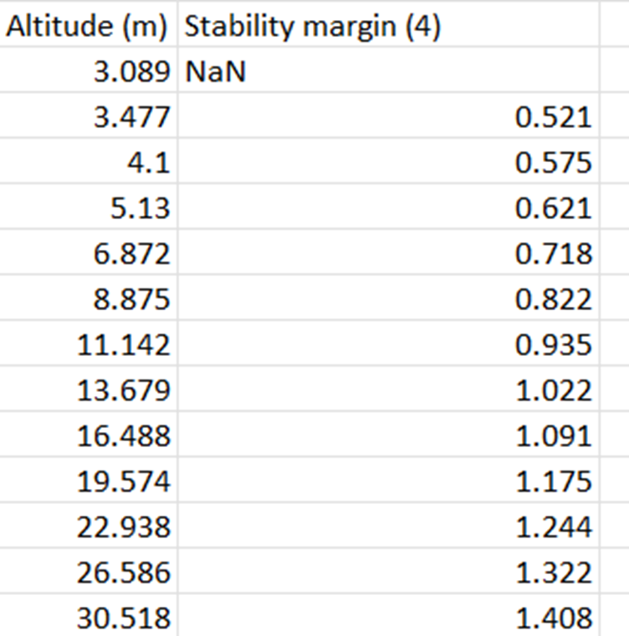
Stability variation vs the altitude..

Slide 9
Progress - Design of the fin alignment jig#23
The proposed idea of the fin alignment jig was worked on this week.
Good progress has been made so far and the design is done.
Purpose: To align the fins orthogonally to the body tube.This will contribute to the aerodynamics of the rocket during launch.

Slide 10
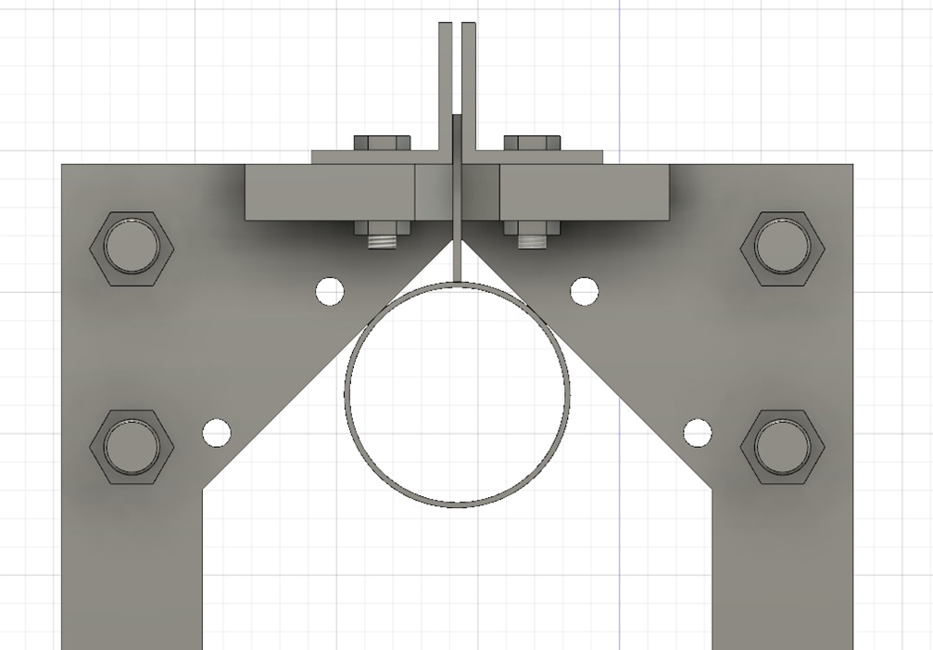
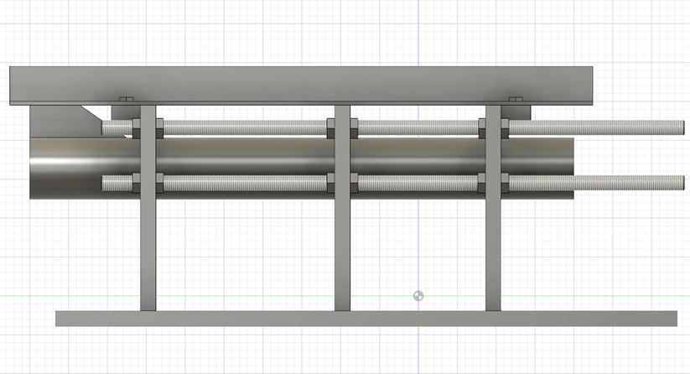
Fin alignment jig design on fusion 360
Blast deflector material→ The engine exhaust expected to reach 1600℃. Stainless steel Grade 430 can withstand upto 1500℃. Refractory material to be applied on surface.

Slide 11
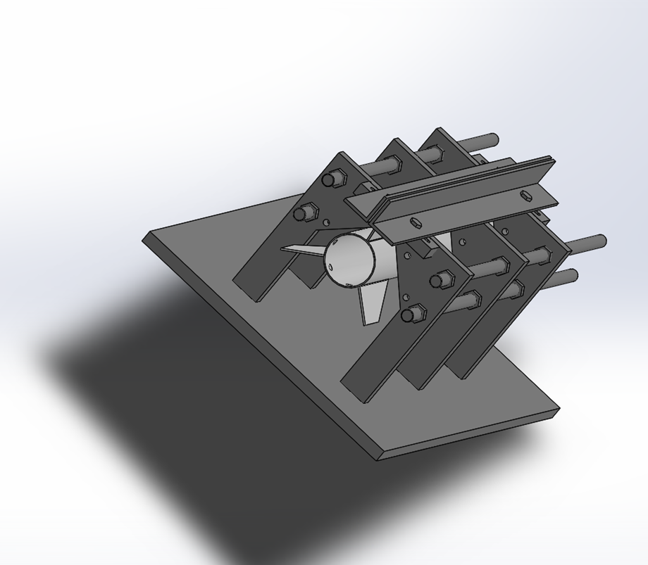
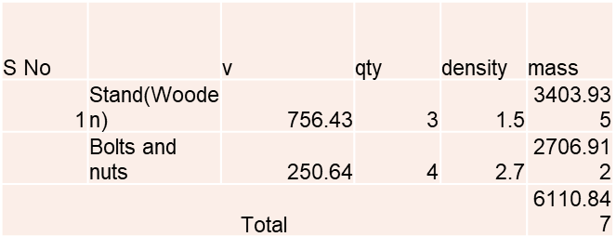
Weight Estimates
Supports size Height=265mm, Width=280mm, t= 2cm

Slide 12
Attention areas
1
Finalise on optimization fabrication of the fibreglass airframe
2
Redesign of the launch pad
Re-adjustments of the avionics bay

Slide 13
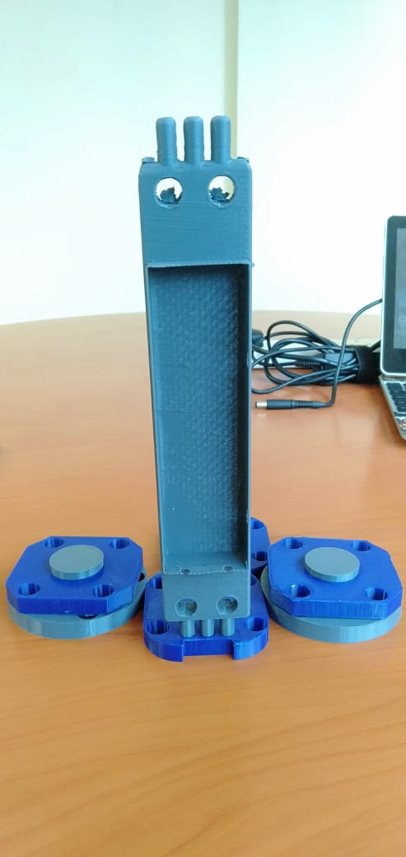
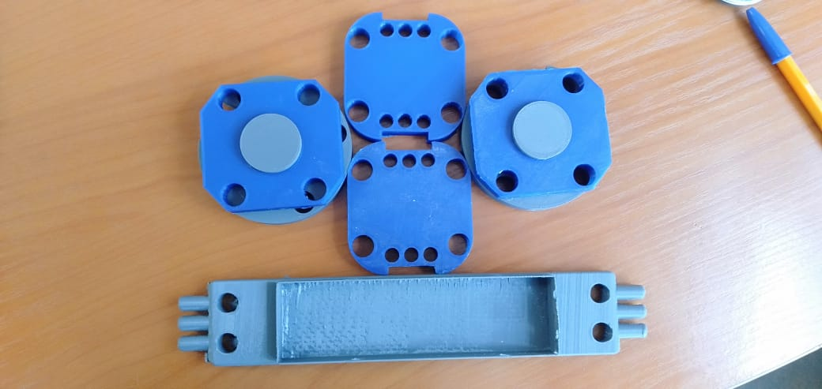
Avionics bay -> needs a bit re adjustments to fit the new battery.

Slide 14
Goals for next week
Expected delivery
March 4th,2023
Fabrication of the airframe(Aluminum)#20
Finalise on optimisation of rocket parameters#6
Redesign of the launch pad#23

Slide 15


